Slide 1
Inventory Management: Drink & Delight
Group C
Tanisha Singh
Pulak Sinha
Sagar Sharma
Shivam Tiwari
Astha

Slide 2
Epic: As a supplier, our main aim would be to deliver raw materials as and when required by DD.
User Stories:
At first, I would login using my login credentials.
Then I would accept the request of raw materials from DD and upload the details of available materials.
Then I would accept payment.
Finally, I would dispatch the order and update the status of materials for tracking.

Slide 3
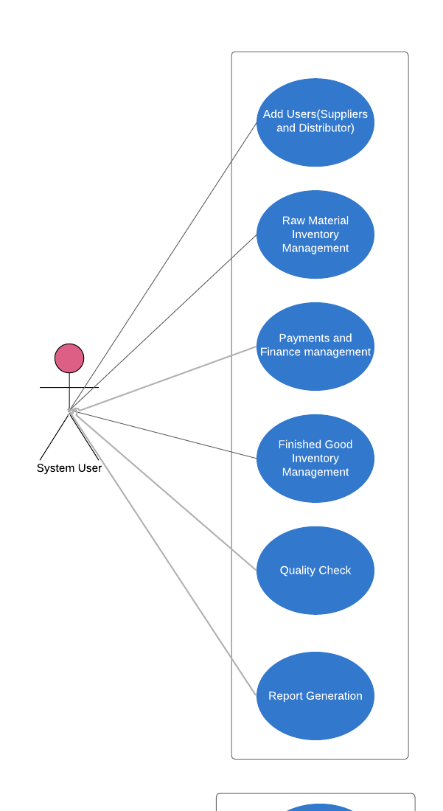
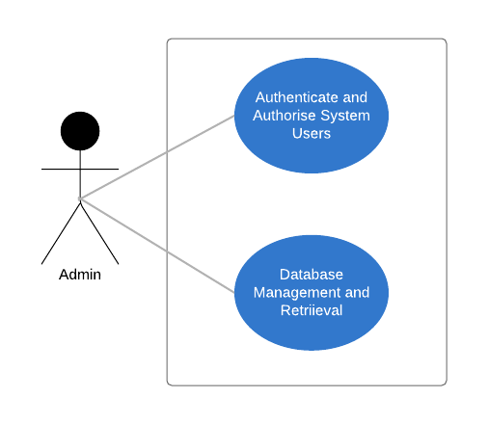
Use Case Diagram Admin and System User

Slide 4
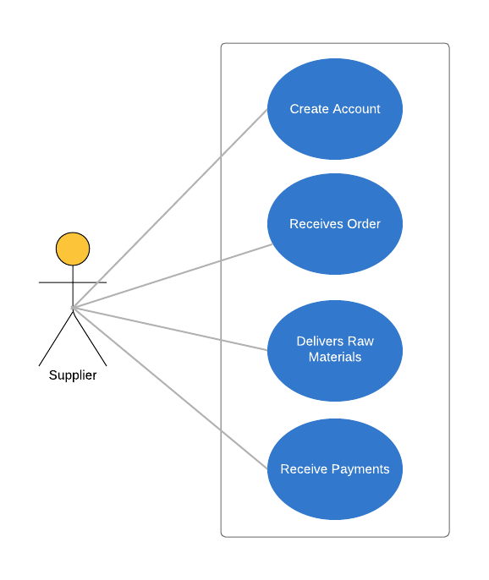
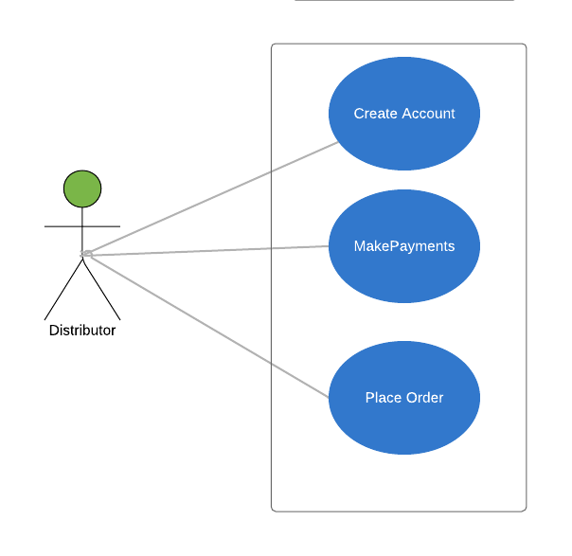
Use Case Diagram Supplier and Distributor

Slide 5
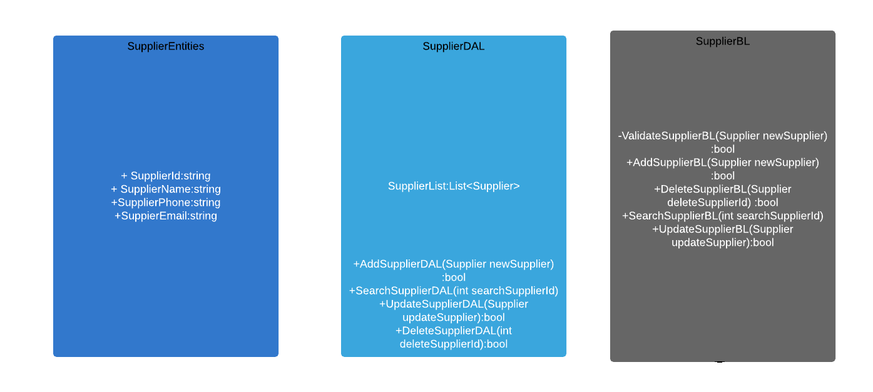
Class Diagram: Supplier

Slide 6
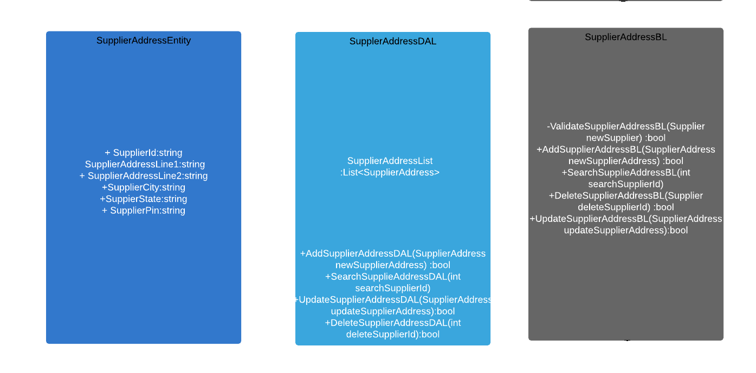
Class Diagram: Supplier Address

Slide 7
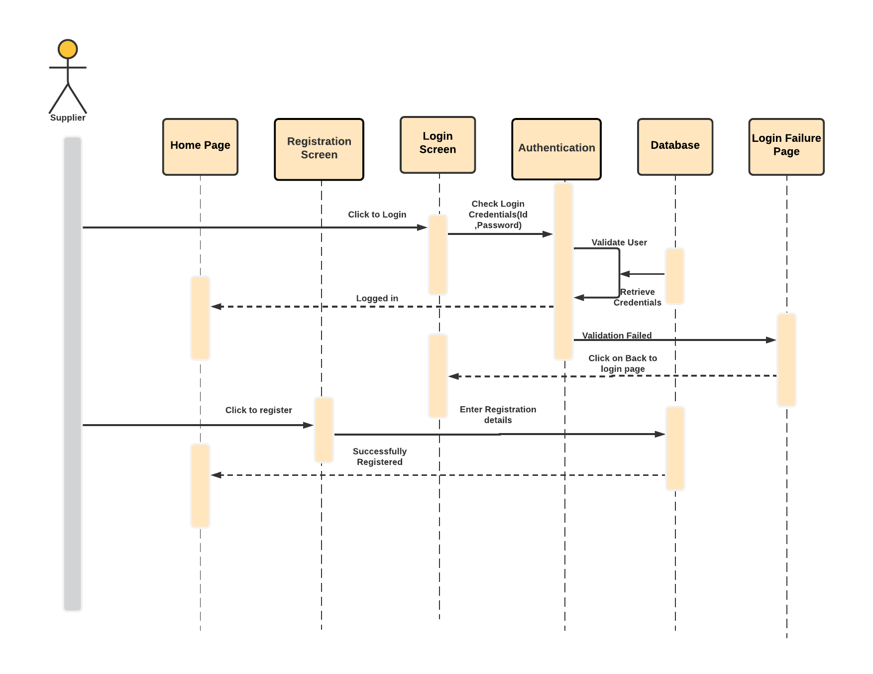
Sequence Diagram: Supplier Login

Slide 8
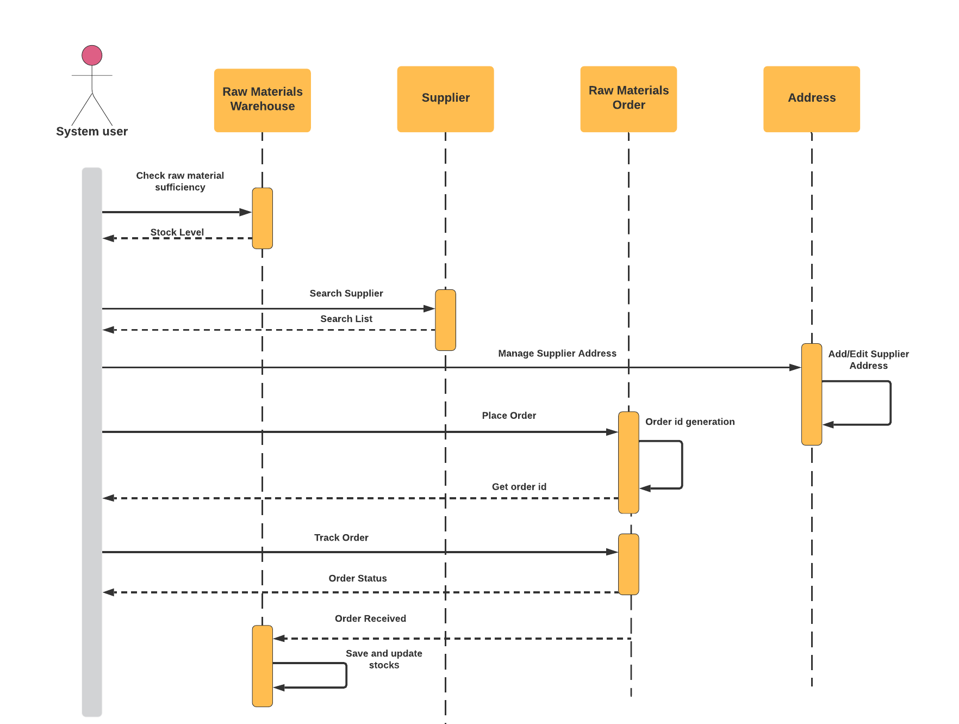
Sequence Diagram: Supplier

Slide 9
Thank You

